Slide 1

Approximation algorithms

Slide 2
To date, thousands of natural optimization problems have been shown to be NP-hard
To deal with these problems, two approaches are commonly adopted:
(a) approximation algorithms
(b) randomized algorithms
approximation algorithms aim to find solutions whose costs are as close to be optimal as possible in polynomial time
Randomized algorithms can be looked at from different angles

Slide 3
Introduction to Approximate algorithm
An Approximate Algorithm is a way of approach NP-COMPLETENESS for the optimization problem.
This technique does not guarantee the best solution.
The goal of an approximation algorithm is to come as close as possible to the optimum value in a reasonable amount of time which is at the most polynomial time.
Such algorithms are called approximation algorithm or heuristic algorithm.

Slide 4
For the traveling salesperson problem, the optimization problem is to find the shortest cycle, and the approximation problem is to find a short cycle.
For the vertex cover problem, the optimization problem is to find the vertex cover with fewest vertices, and the approximation problem is to find the vertex cover with few vertices.

Slide 5
Approximation algorithms
Guaranteed to be run in polynomial time
Guaranteed to get a solution which is close to optimal solution
Challenge -need to prove a solution’s value close to optimal value,without even knowing what the optimum value is

Slide 6

Definition of approximation algorithms
Let P be an optimization problem, an algorithm A is said to be approximation algorithm for P, if for any given instance I, it returns an approximation solution, that is a feasible solution

Slide 7
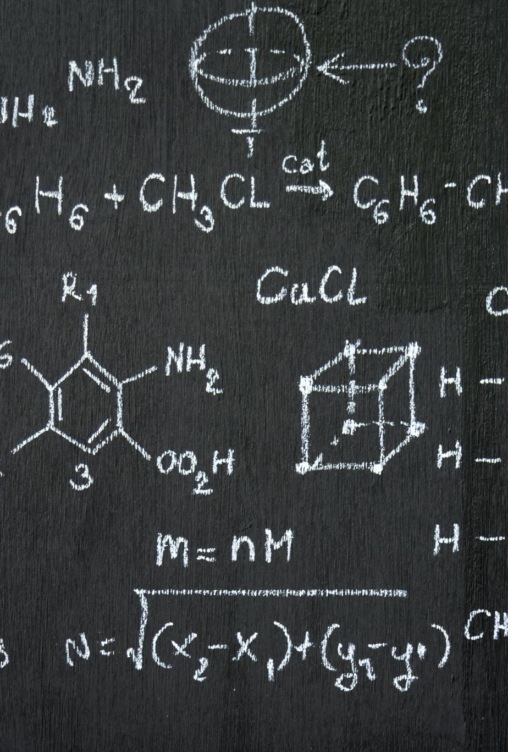
Types of approximation algorithms
P an optimization problem
A an approximation algorithm
I instance of P
A*(I) optimal value for instance I
A(I) value of instance I generated by A

Slide 8
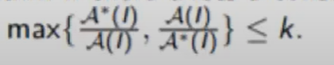
Absolute approximization
A is absolute approximation algorithm if there exist a constant K such that for every instance I of P,
|A*(I)-A(I)|<=K
Eg- planar graph coloring
Relative approximization
A is relative approximization algorithm ,if there exist a constant K such that ,for every instance I of P
Eg- vertex cover
This is called approximation ratio

Slide 9
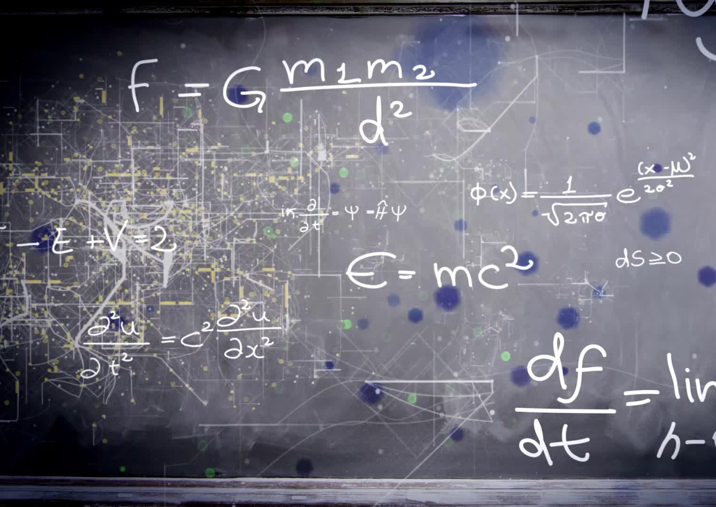
2-approximation algorithm for Vertex Cover problem

Slide 10
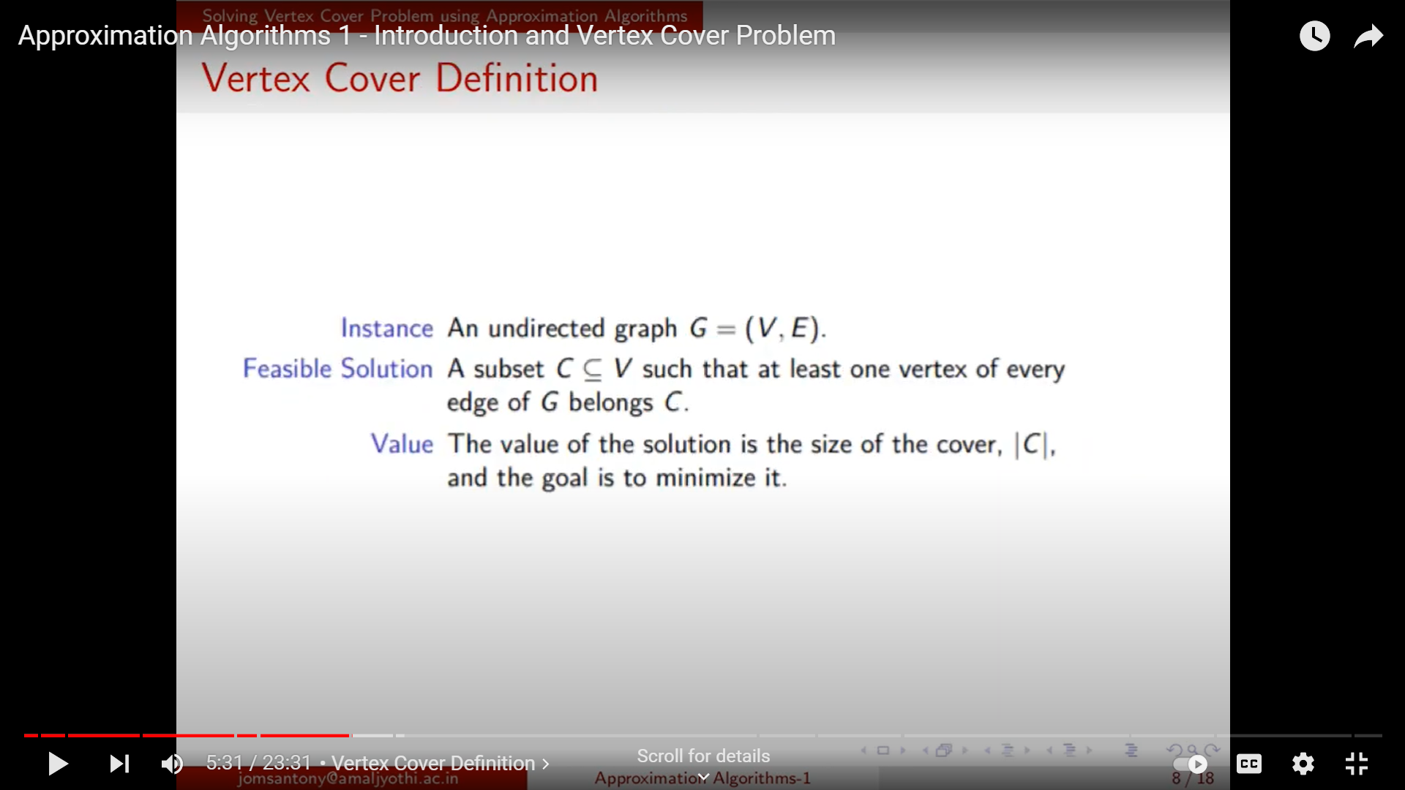



Vertex cover definition

Slide 11
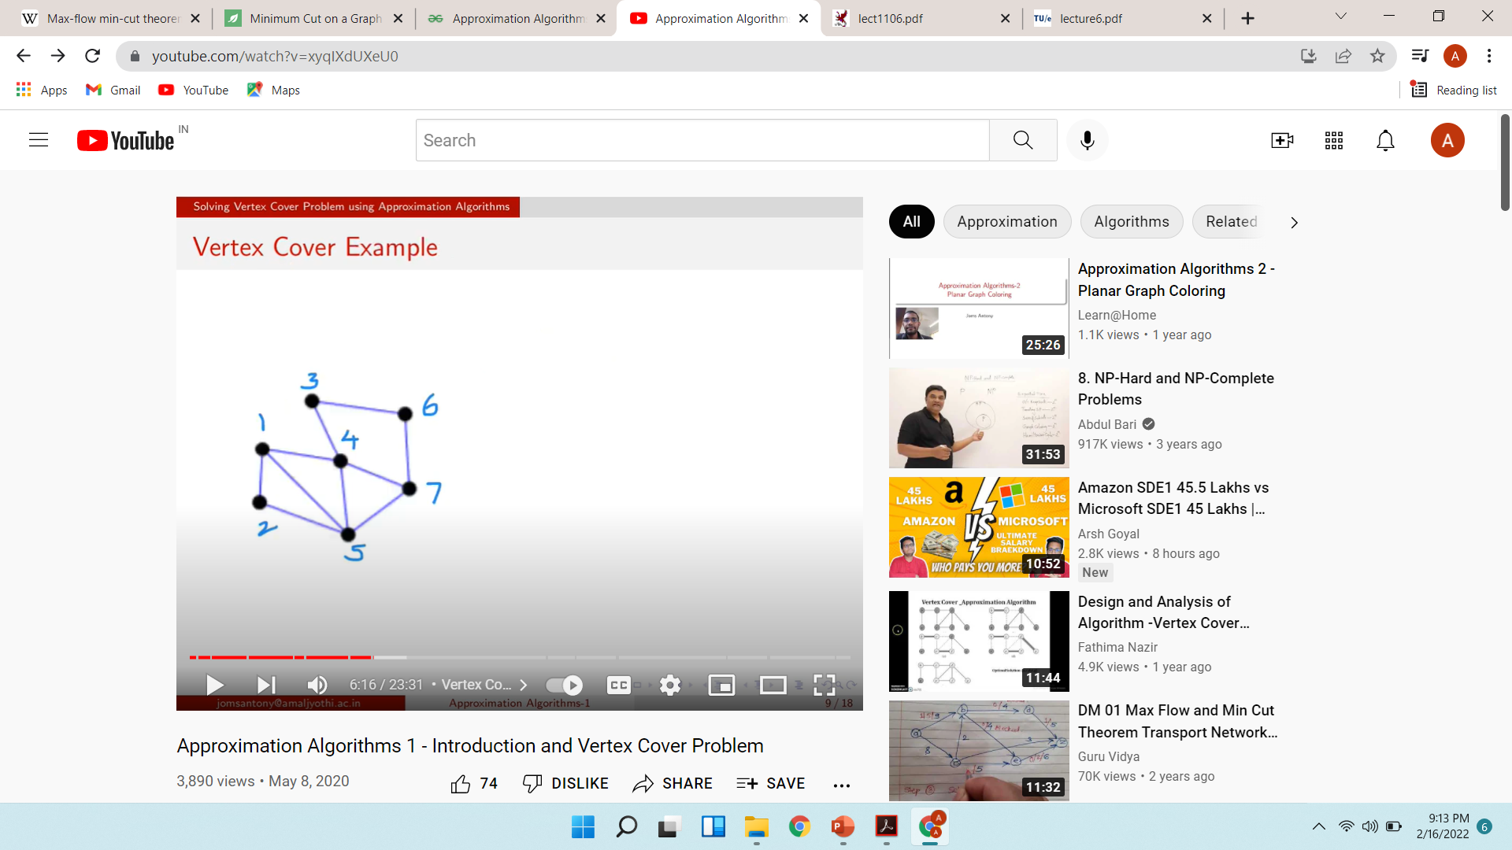




Example

Slide 12
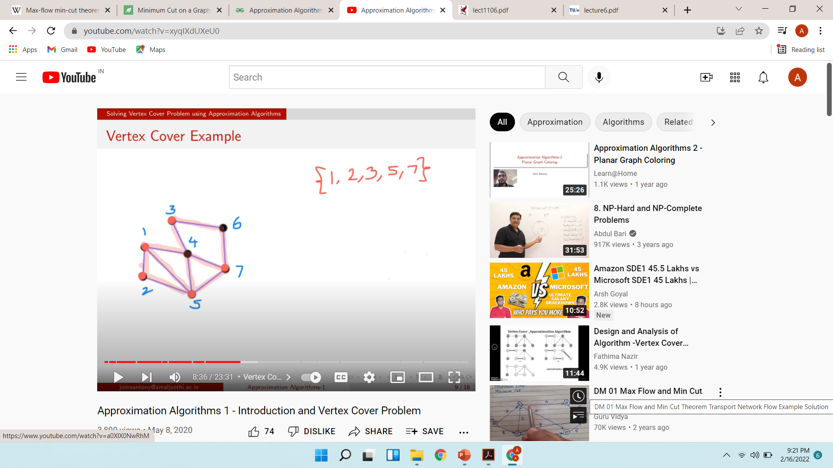
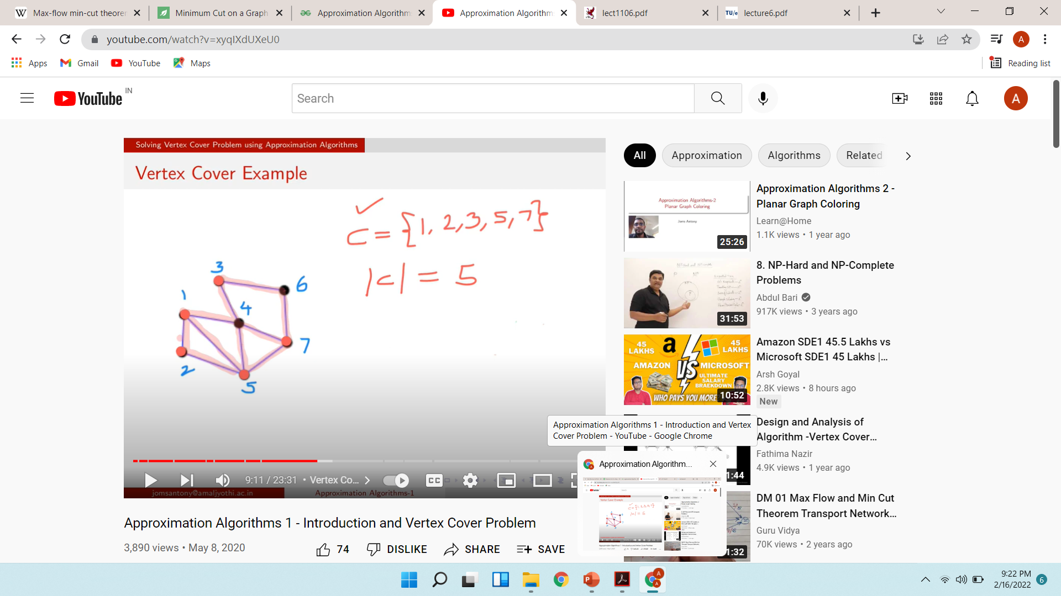

Slide 13

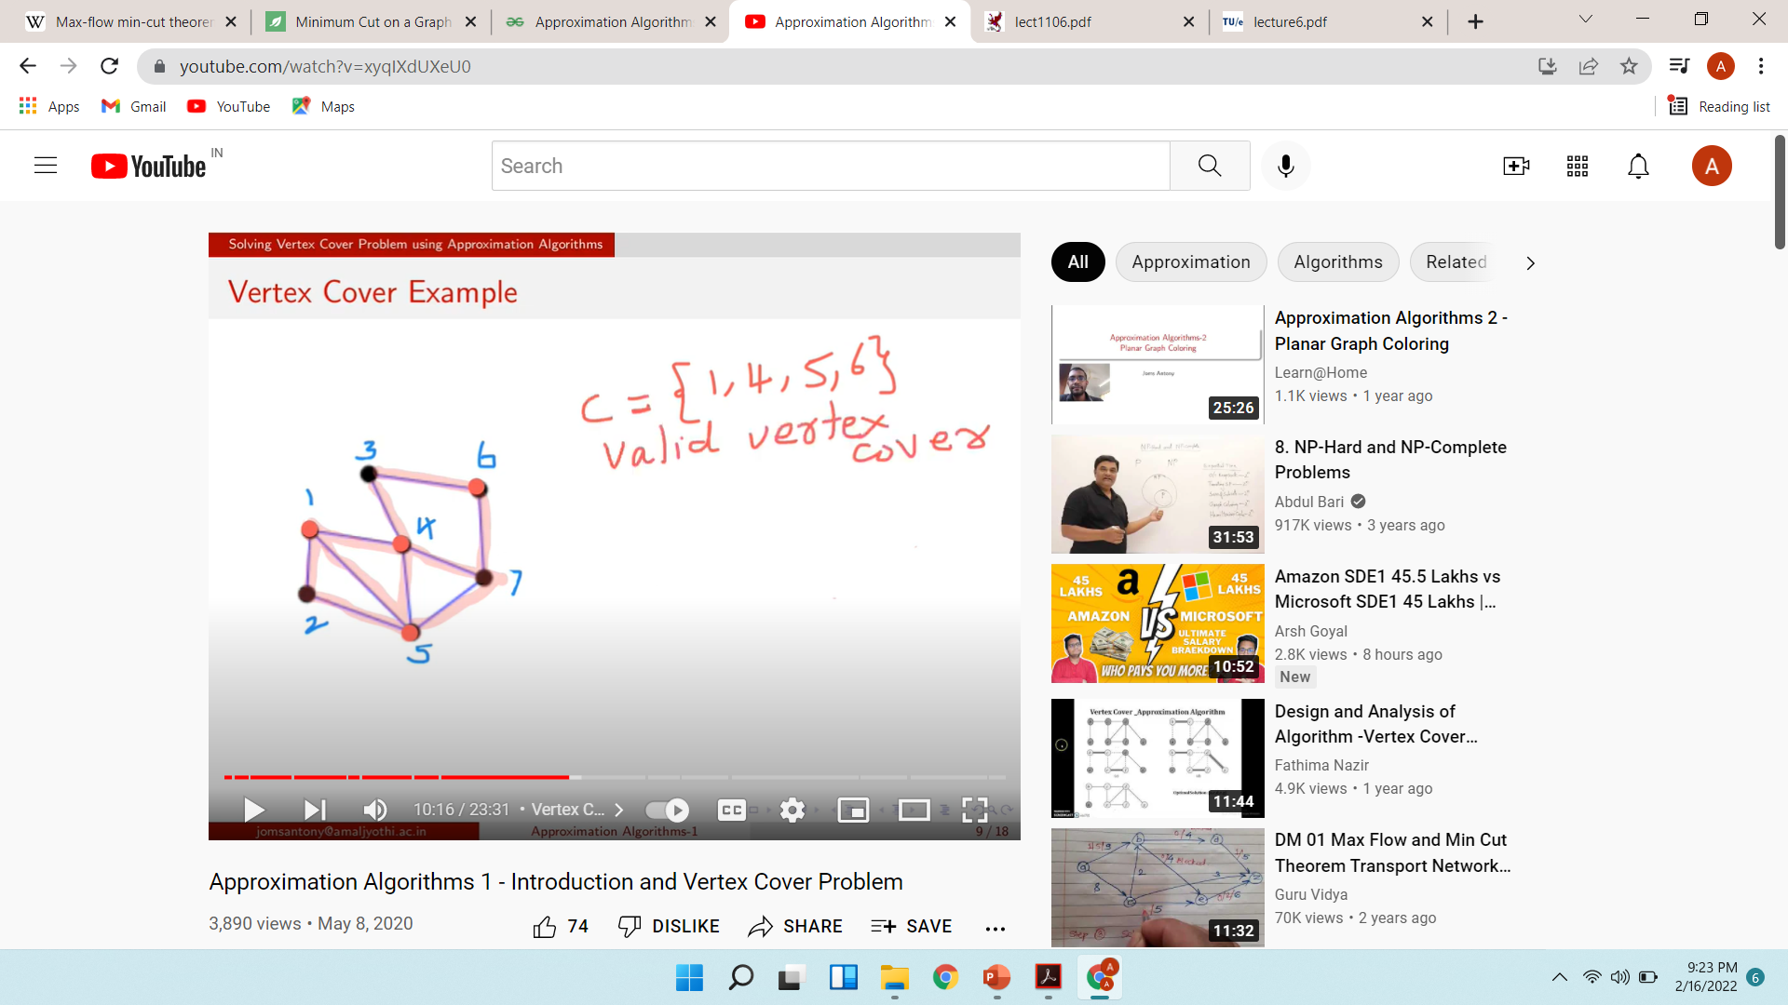
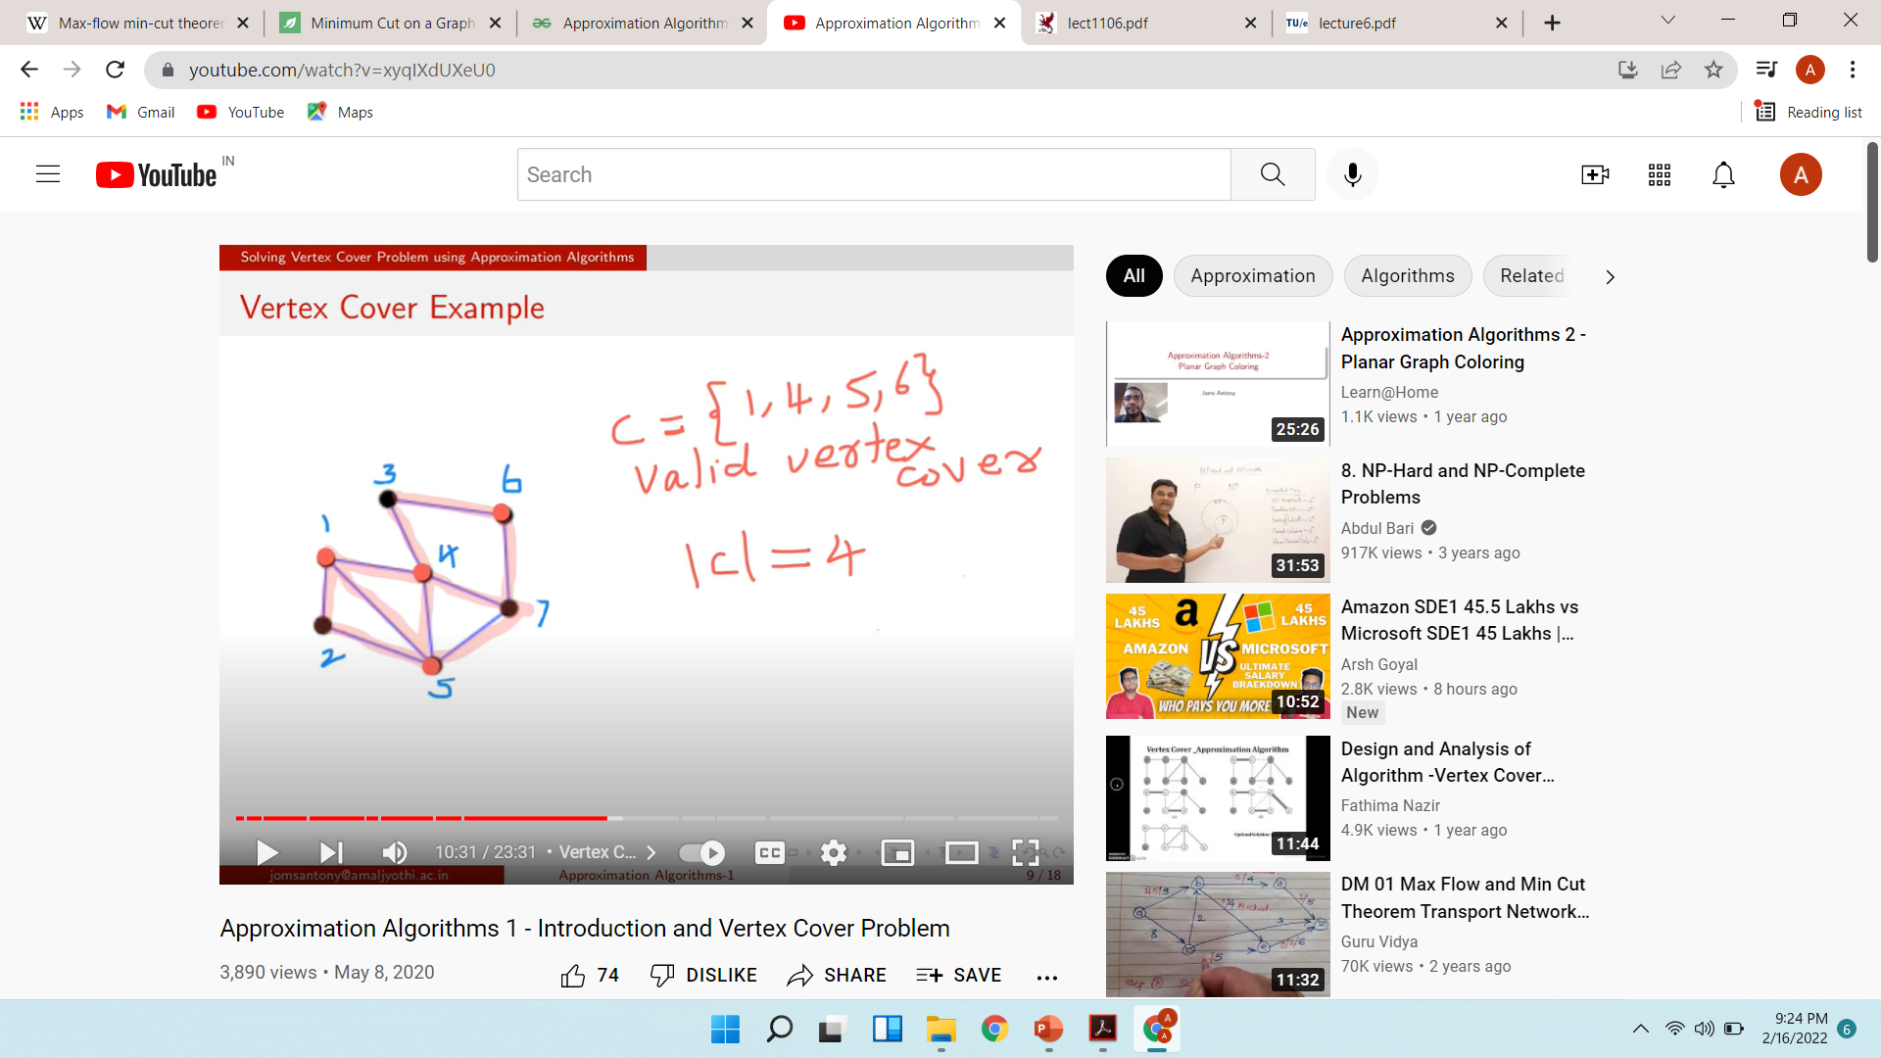

Slide 14

The vertex-cover problem

Slide 15
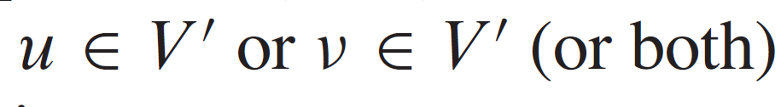
a vertex cover of an undirected graph G =(V;E) is a subset V’ such that if.(u,v)is an edge of G, then either
The size of a vertex cover is the number of vertices in it.

Slide 16
The vertex-cover problem
The vertex-cover problem is to find a vertex cover of minimum size in a given undirected graph.
We call such a vertex cover an optimal vertex cover.
we don’t know how to find an optimal vertex cover in a graph G in polynomial time, we can efficiently find a vertex cover that is near-optimal.
The following approximation algorithm takes as input an undirected graph G and returns a vertex cover whose size is guaranteed to be no more than twice the size of an optimal vertex cover.

Slide 17
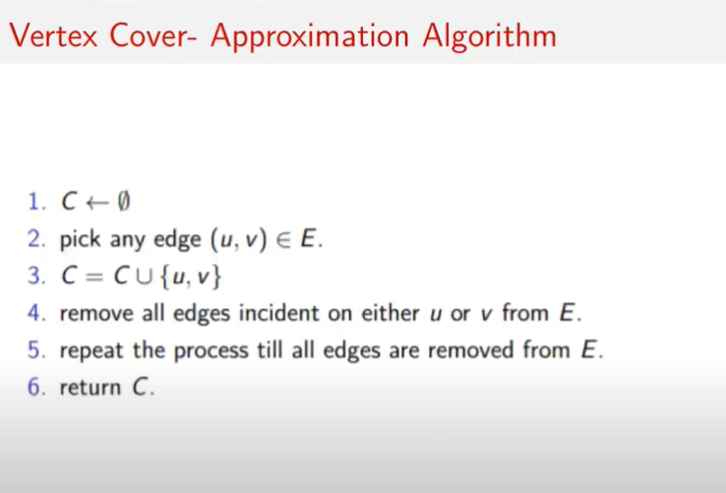

Slide 18


Slide 19
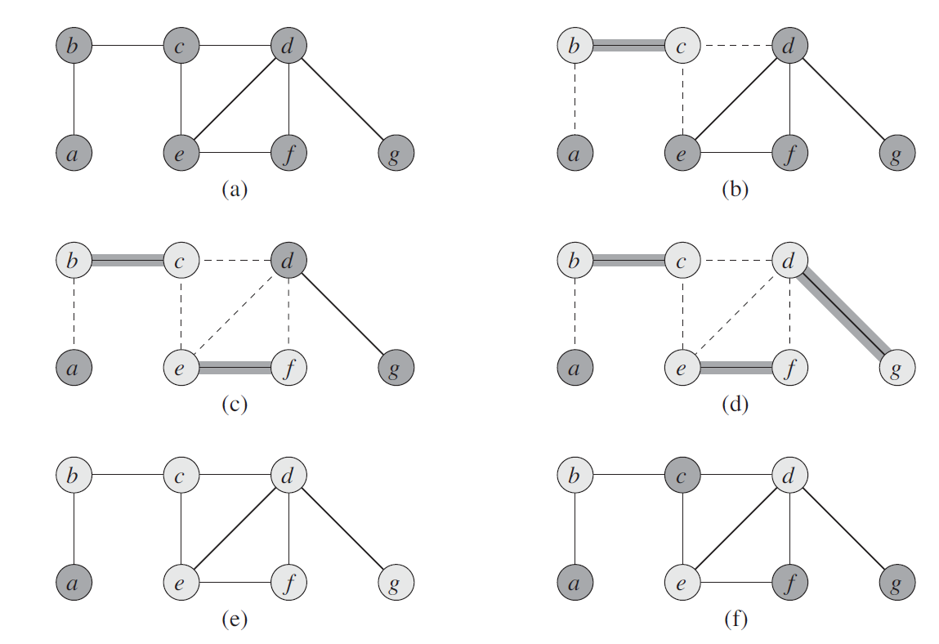
The set C, which is the vertex cover produced by
APPROX-VERTEX-COVER, contains the six vertices b; c; d; e; f; g.
The optimal vertex cover for this problem contains only three vertices: b, d, and e.

Slide 20
Line 1
initializes C to the empty set.
Line 2
sets E’ to be a copy of the edge set G:E of the graph.
The loop of lines 3–6
repeatedly picks an edge (u,v) from E’ , adds its endpoints u and v to C, and deletes all edges in E’ that are covered by either u or v .
Finally, line 7
returns the vertex cover C.
The running time of this algorithm is O(V+ E)using adjacency lists to represent E’
The set C obtained in is a 2-approximation Vertex Cover.

Slide 21
Approximation Ratio: The resulting set C is guaranteed to be at most twice the size of the optimal Vertex Cover.
Proof of 2-Approximation:
Let C∗ be the optimal Vertex Cover, and ∣C∗∣ be its size.
Each edge (u,v) in the graph is covered by at least one vertex in C∗.
As the algorithm selects both u and v for each edge, ∣C∣=2×number of edges
Therefore, ∣C∣≤2×∣C∗∣, proving the 2-approximation.

Slide 22
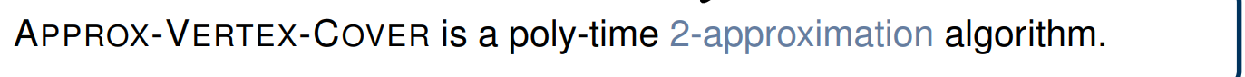
An algorithm with approximation ratio k is called a k-approximation algorithm;

